Slide 1
JIBEBE MECHANICAL TEAM WEEK 2
Kenedy Ouma

Slide 2
MODIFICATION OF MOTOR AND BATTERY MOUNT DESIGN
This was to better suit the applicability ie. so that it may accomodate and support both the motor and the battery .

Slide 3
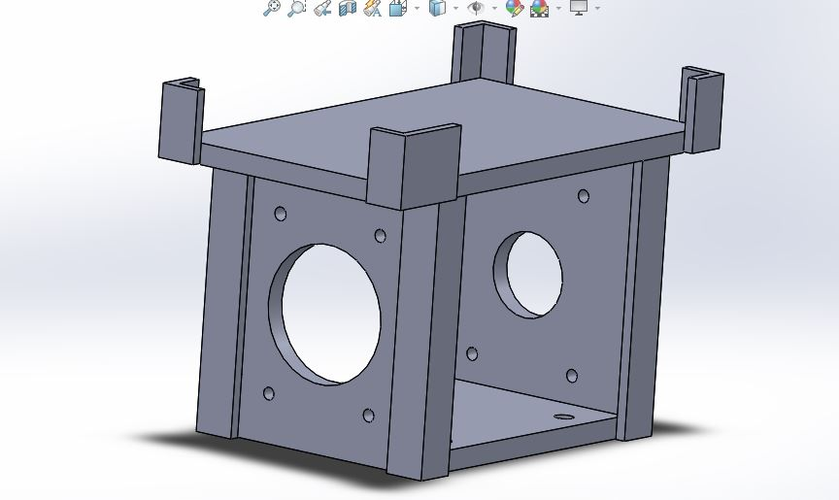

Slide 4
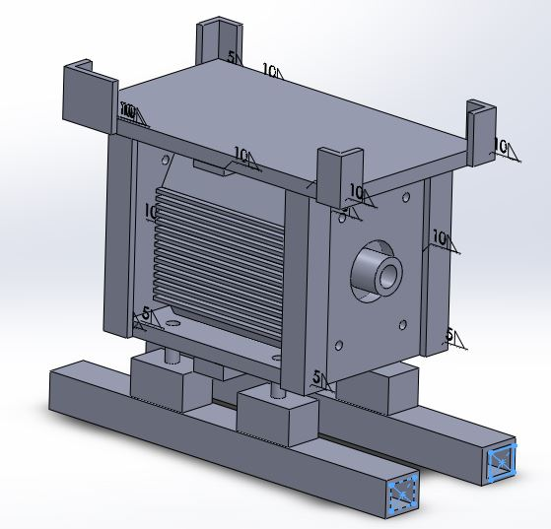

Slide 5
SIMULATION OF THE DESIGN
From the simulation we deduced that:
The material will be mild steel
Mild steel sheets of a 20mm width
Angle lines : 2 in by 2 in by 5mm

Slide 6
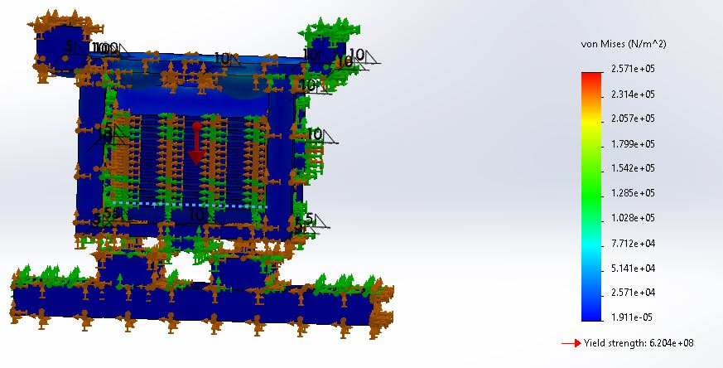

Slide 7
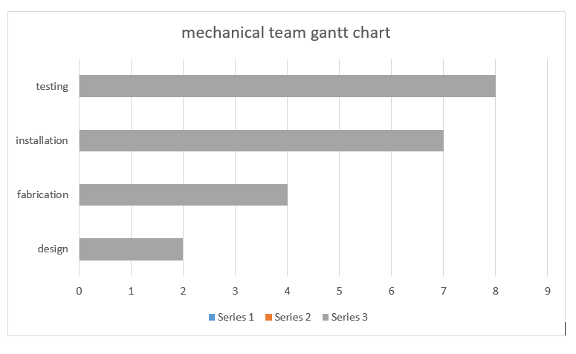

Slide 8
ACQUISITION OF MATERIALS
We have acquired the quotations of the materials needed to kick off fabrication process

Slide 9
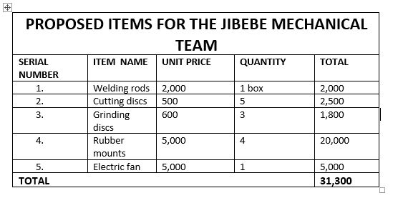

Slide 10
THANK
YOU
😀

